Slide 1


TECH REVIEW HUB
Krishna Singhal
202501101400022

Slide 2
Product Browsing
Use Case Overview
Users can browse tech products in four categories:
Mobiles
Laptops
Smartwatches
Tablets
Each category displays multiple brands with multiple devices
Viewing Product Details
For every device, users can see:
Product name
Product image
Key specifications
Category & brand
This helps them understand the features before buying.
Easy navigation across pages
For every device, users can see:
Product name
Product image
Key specifications
Category & brand
This helps them understand the features before buying.

Slide 3
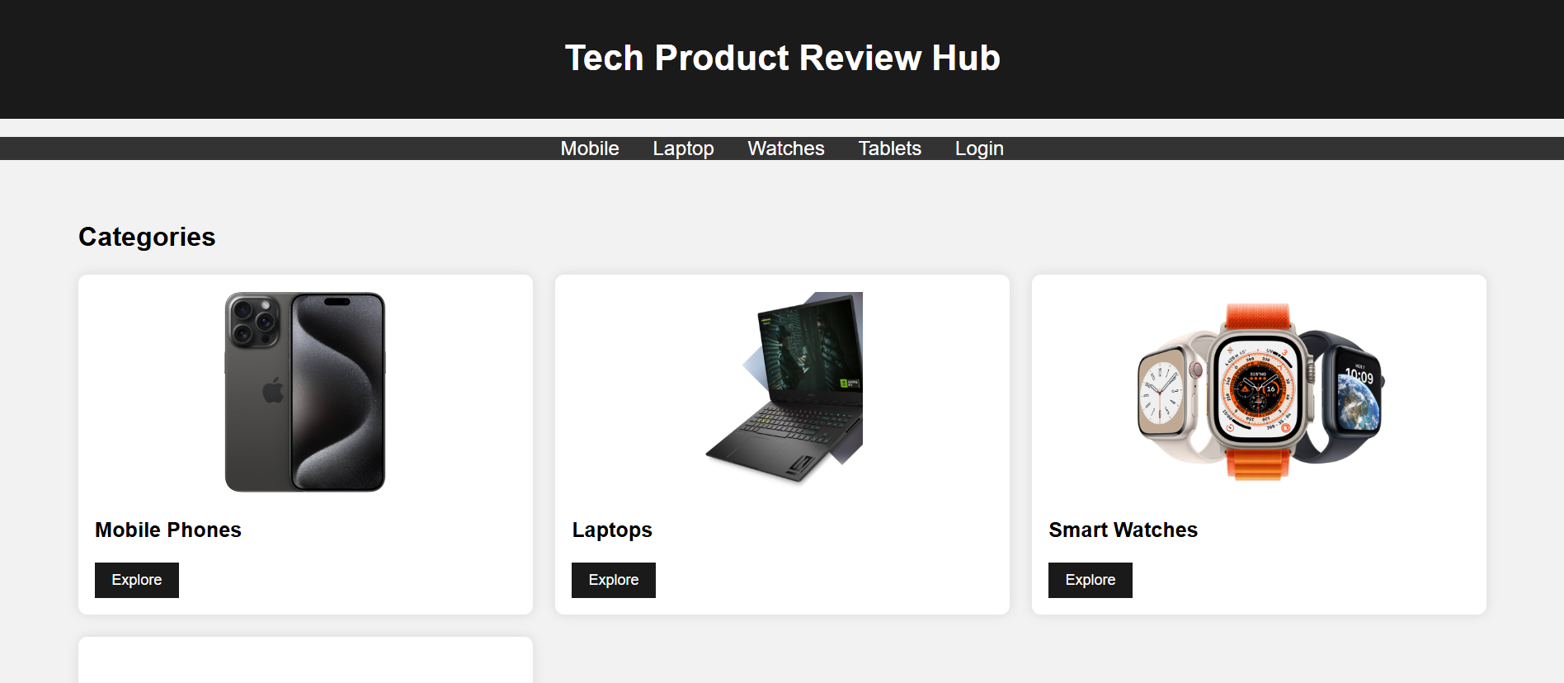
Website Snapshots
This section provides visual snapshots of the Tech Product Review Hub. Here, you’ll find examples of the home page layout, category pages for various devices, individual product cards, and the review section that allows users to share their feedback effectively.

Slide 4
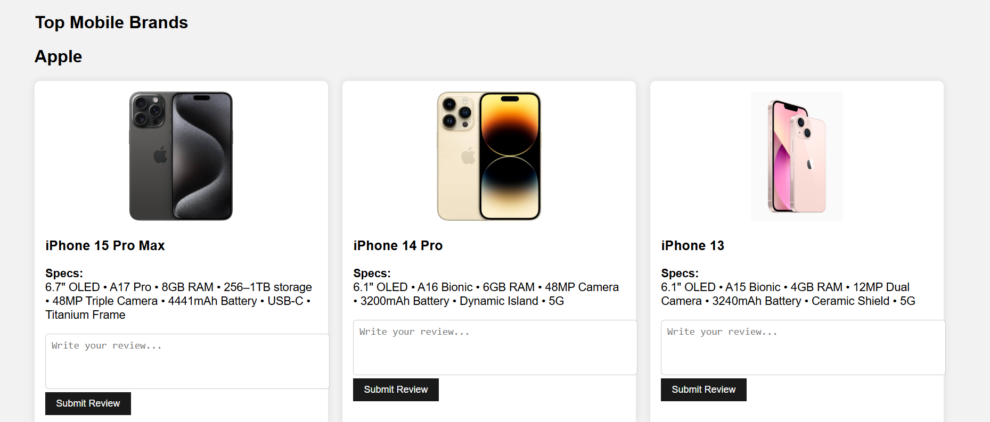
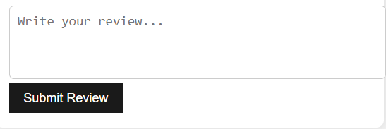
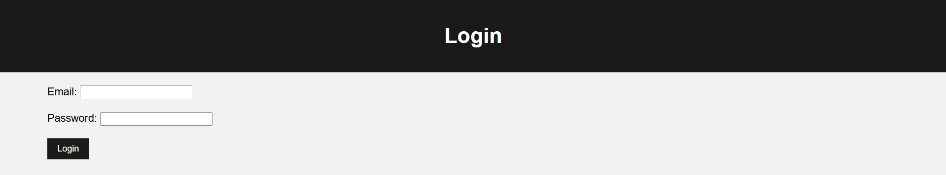

Features Implemented in the Project
Clean UI
The platform features a simple and intuitive design.
Review Text Box
Login Page
Users can add feedback through a fixed text box.
Includes JavaScript validation for user email input.

Slide 5
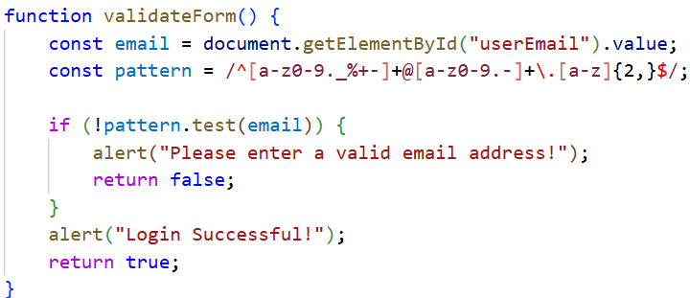
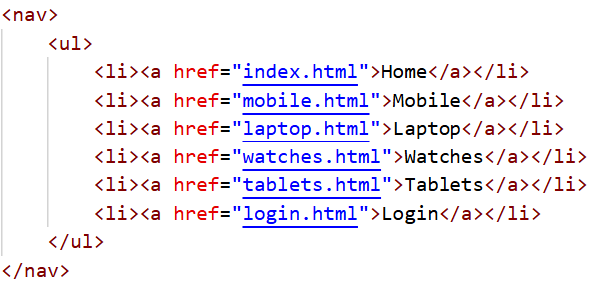
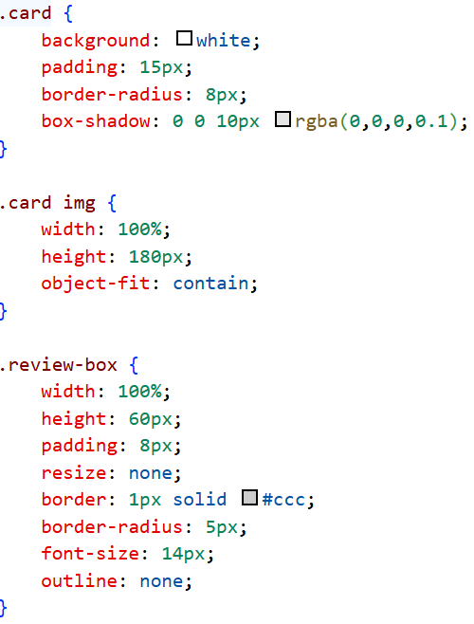
Important
code snippets
Email Validation(JS Recquired)
Navigation Bar (Common Header Section)
CSS for Product Cards (Important Styling Code)

Slide 6
Thank You!

